Slide 1


TII Road Safety Seminar
N5 Frenchpark HD15 RSIS
John Freeman
Senior Executive Engineer

Slide 2
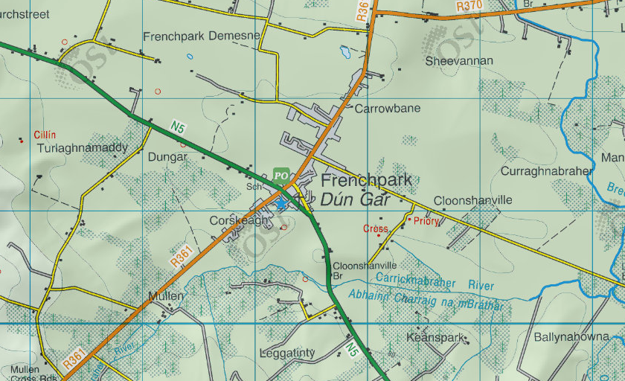
Introduction
Frenchpark is a small town/village located on the N5 National Road linking Longford and Westport
The village is formed around a crossroads where the N5 intersects with the R361
AaDT is 5500 vehicles on the N5 and 1900 on the R361 regional road
Identified as a High Collision Location (HCL) site by TII in 2014 (Round G)

Slide 3
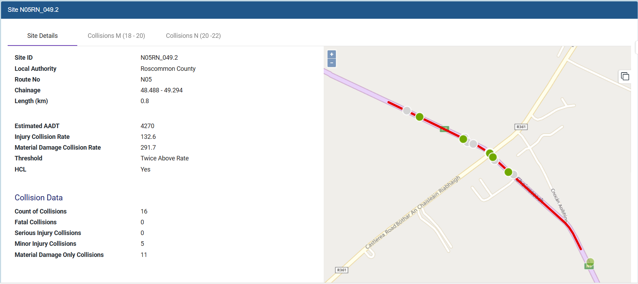
TII Collision History
fffRound N collision data –
5 Injury Collisions & 11 Material damage Collisions

Slide 4
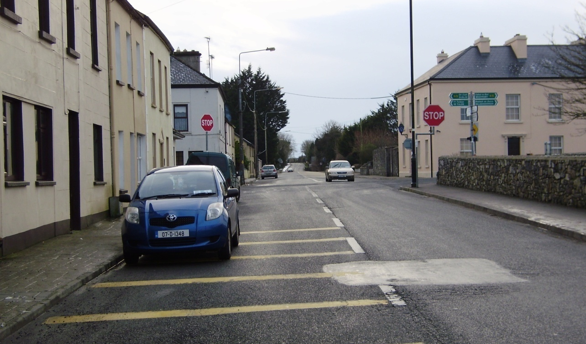
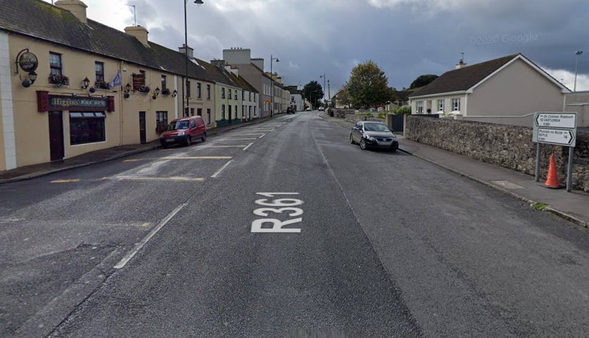
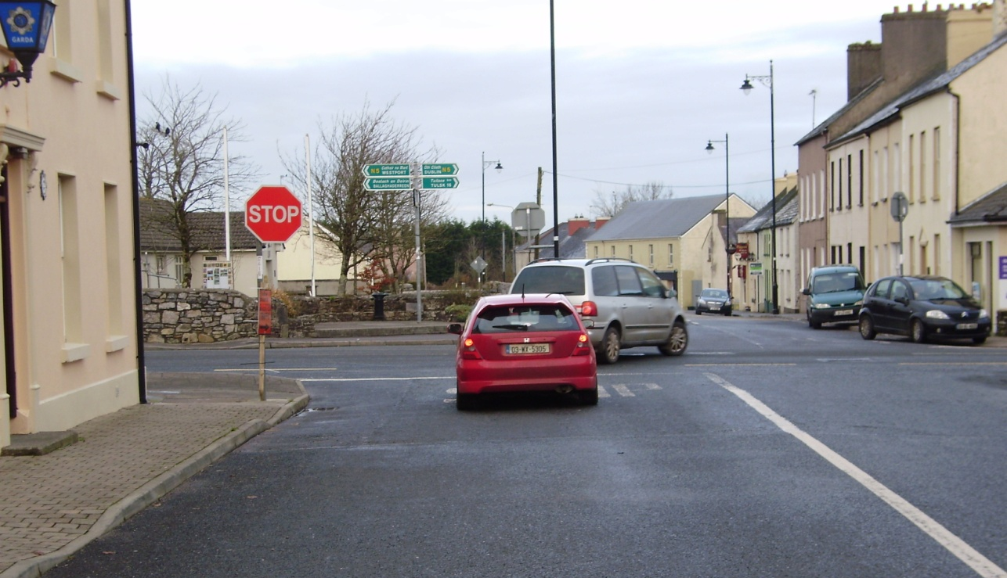
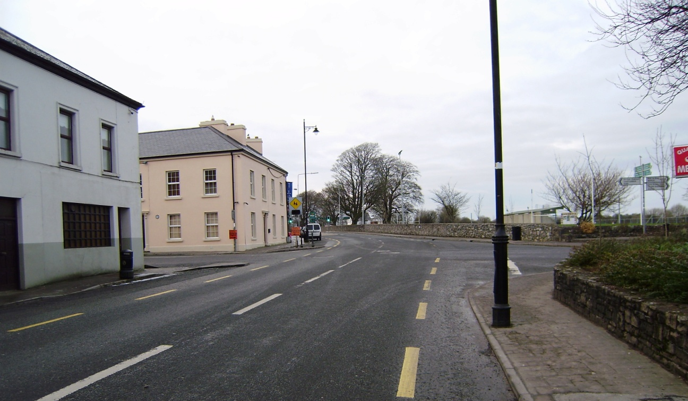
Legacy Safety Issues in Frenchpark
Direct Line of sight through the junction on the R361
Wide street on the R361 approach from Boyle
Poor visibility for drivers accessing the N5 from Castlerea
Illegal parking in and around the junction obstructing driver visibility and presenting hazards for vulnerable road users
Lack of safe crossing facility on the national road

Slide 5
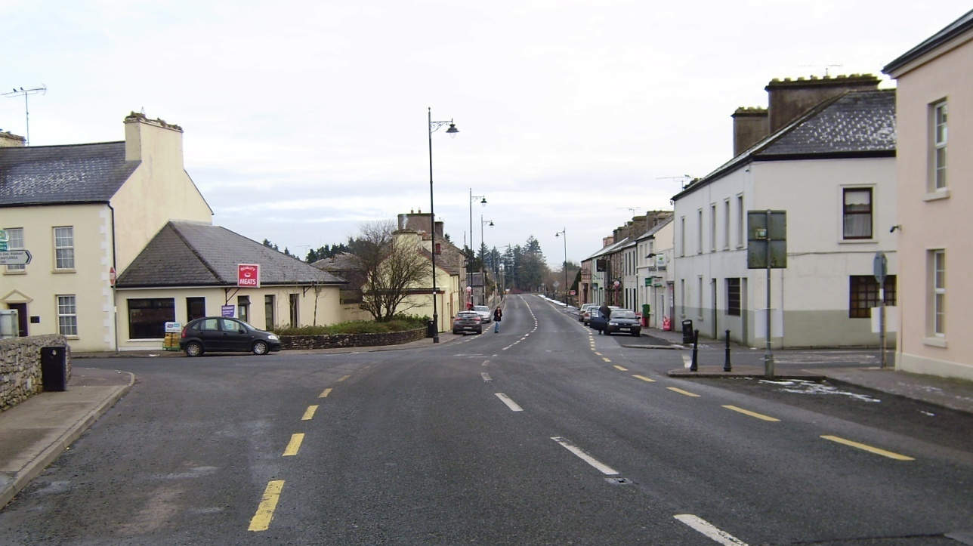
Collision History
Analysis of collision specifics indicated that a pattern of 2 vehicle angular (T bone) type collisions are occurring at this location as a result of driver failure to recognise the junction layout.
Collision history shows a pattern of R361 traffic entering the junction with the N5 and being struck by N5 traffic -
R361 NB vehicle is aware of the approaching junction, stops and looks in either direction but fails to see approaching traffic as a result of blocked sightlines, inadequate effort, etc.
R361 SB vehicle is not aware of the approaching junction and drives into the junction without stopping and without looking left or right.

Slide 6
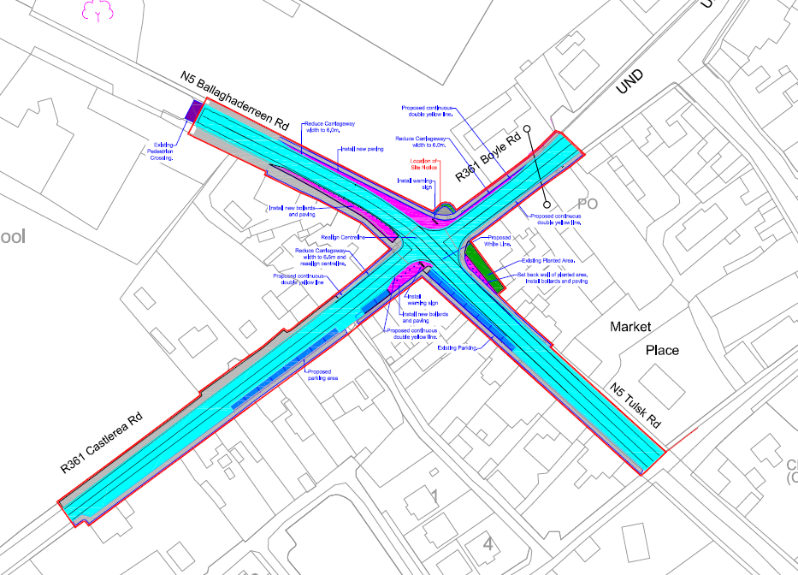
2016 Safety Improvement Scheme
Frenchpark Village was identified as a HD15 site in 2014
The scheme shown here was designed as a junction improvement scheme to reduce parking around the junction and provide less of a clear view through the junction on the regional road
A Part 8 planning application was prepared however it was withdrawn

Slide 7
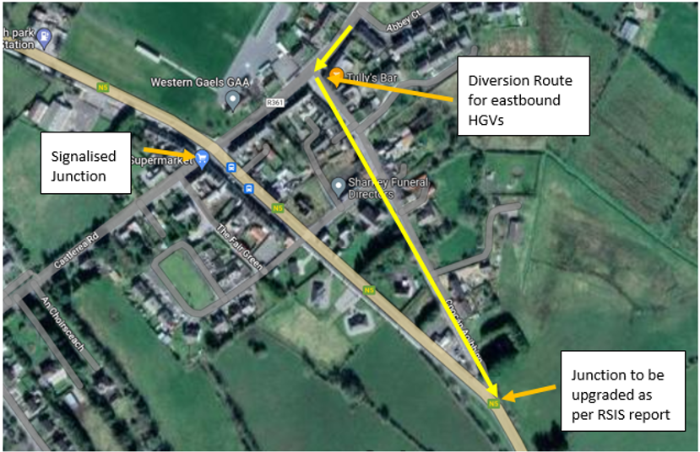
2023 Safety Improvement Scheme
Options Selection:
Do nothing – No benefits
Submit the 2016 scheme for Part 8 planning – (some safety benefits although unlikely to receive support due to loss of parking)
Provide a signalised junction between the N5 and R361 to include pedestrian crossings on each arm

Slide 8
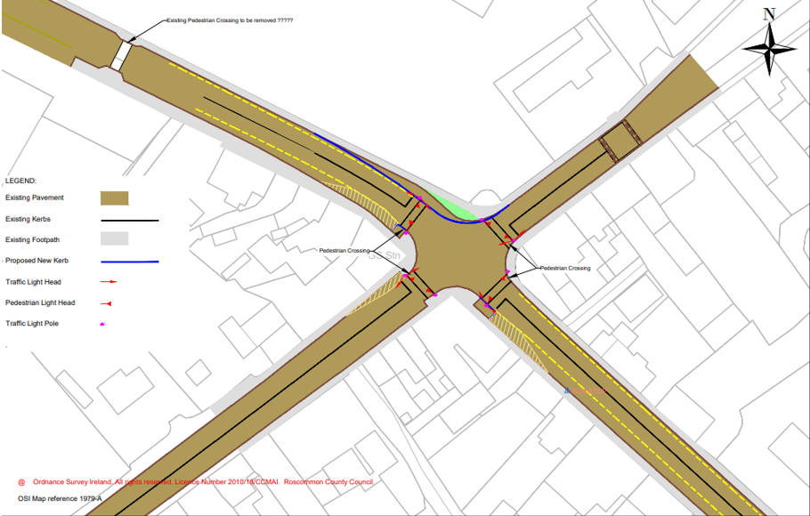
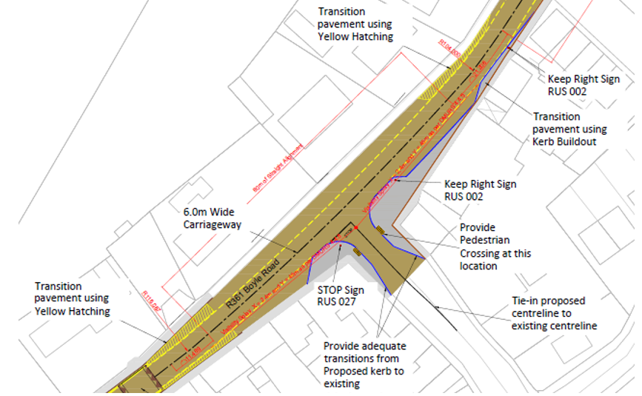
2023 Safety Improvement Scheme
Signal controlled junction on N5 with safe crossing facilities. Traffic lights set to “Rest on Red” to inhibit speeding traffic through the village.
Junction tightening and street narrowing on the R361 approach to the village. This junction included as part of the scheme to facilitate eastern bound articulated vehicles.

Slide 9
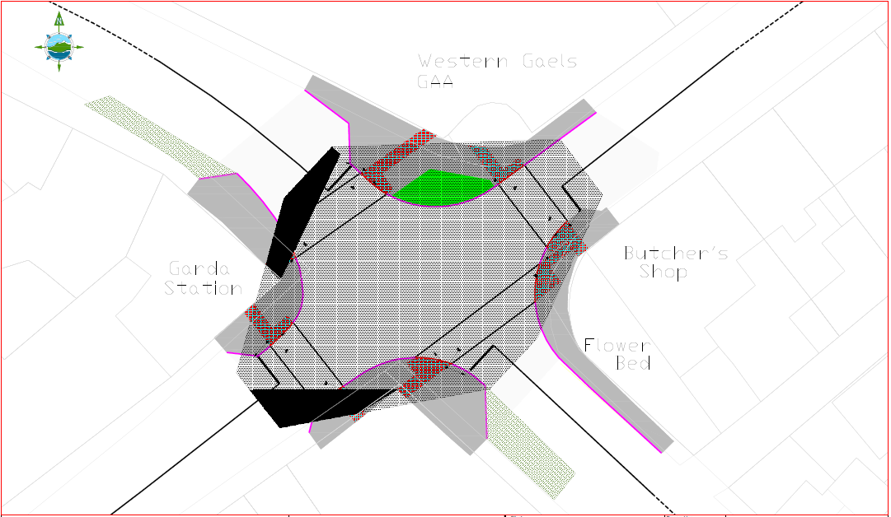
Departures
Departure Type – Intervisibility
Standard Required – Full Intervisibility
TII Publication Standard – (at the time)
DN-GEO-03044
Paragraph 2.16 – At new signalised junctions major obstructions to intervisibility within the junction intervisibility zone, such as that caused by buildings should be avoided. Under these conditions each obstruction to visibility shall be considered as a Departure from Standard and measures shall be taken to mitigate the effects on intervisibility
Constraint – To provide full intervisibility as per the standard
Design Decision – Where an alternative option is available for HGVs intervisibility of pedestrians at crossing points takes priority

Slide 10
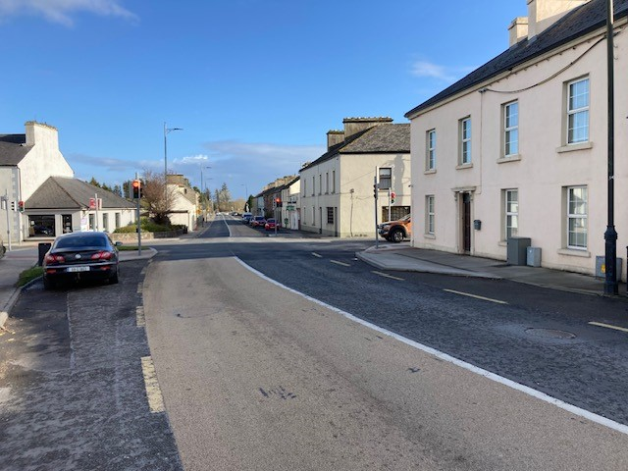
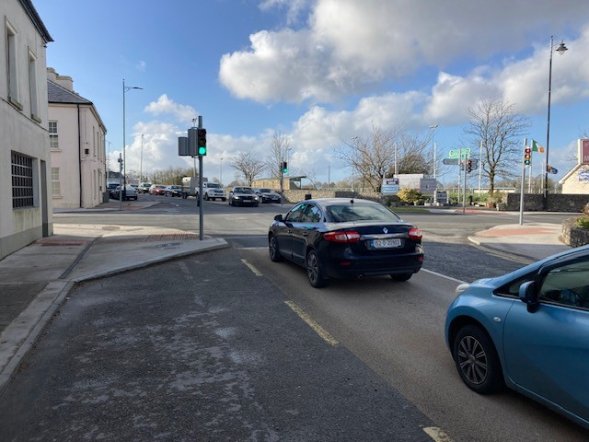
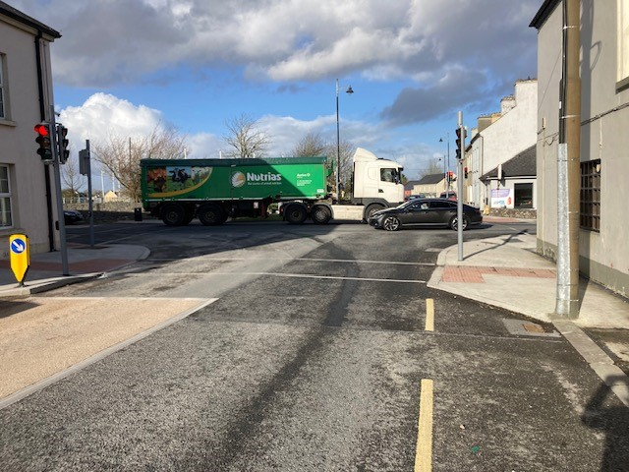
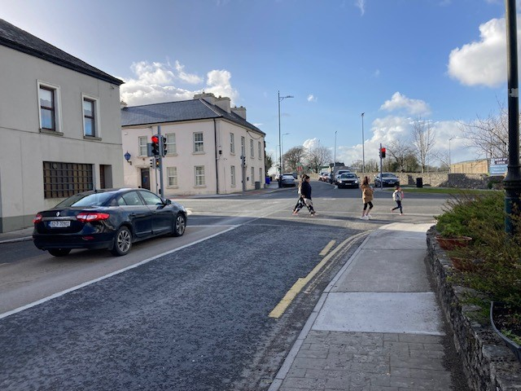

Completed Scheme
Positive Results :
Vehicle speeds through the village particularly HGVs has been considerably reduced
Lower speeds passing primary school
Safe access from regional road to N5
No traffic driving straight through junction
Safe pedestrian crossing facilities on all arms
Locally – all misgivings and concerns prior to project have been forgotten about
Phasing of lights has worked very well to keep traffic moving
No collisions or near misses since

Slide 11

Early engagement with local stakeholders is important – Understand the local issues
Develop an approved safety scheme with TII road safety section
Provide a clear understanding of the proposed scheme and safety benefits to elected members
Loss of parking appears to be a significant issue in the development of safety improvement works in rural towns
All councillors may not be in favour of the approved safety scheme however the best solution should be pursued through the Part 8 or appropriate statutory process
A good safety scheme should not be compromised just to get approval. Its important that the roads authority and TII put forward the best scheme as designed to address all the safety issues.
Its very hard to please everybody!
Thank You

