Slide 1


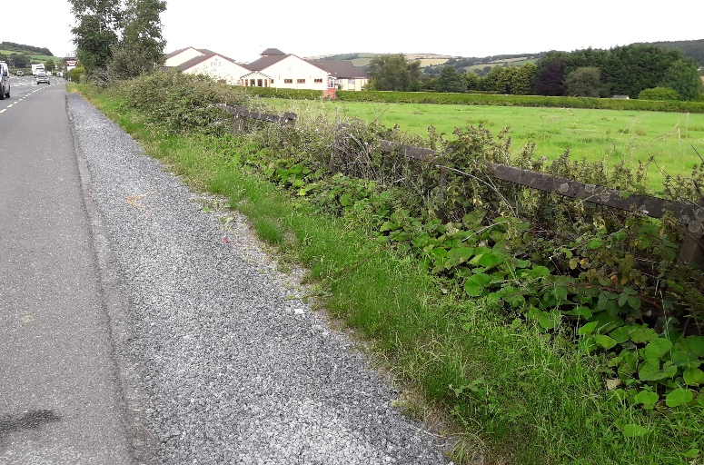
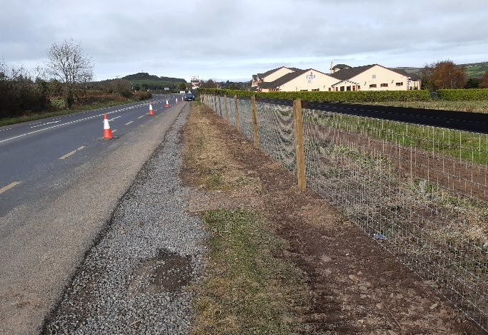
TII Fencing Retrofit
Local Authority Schemes

Slide 2
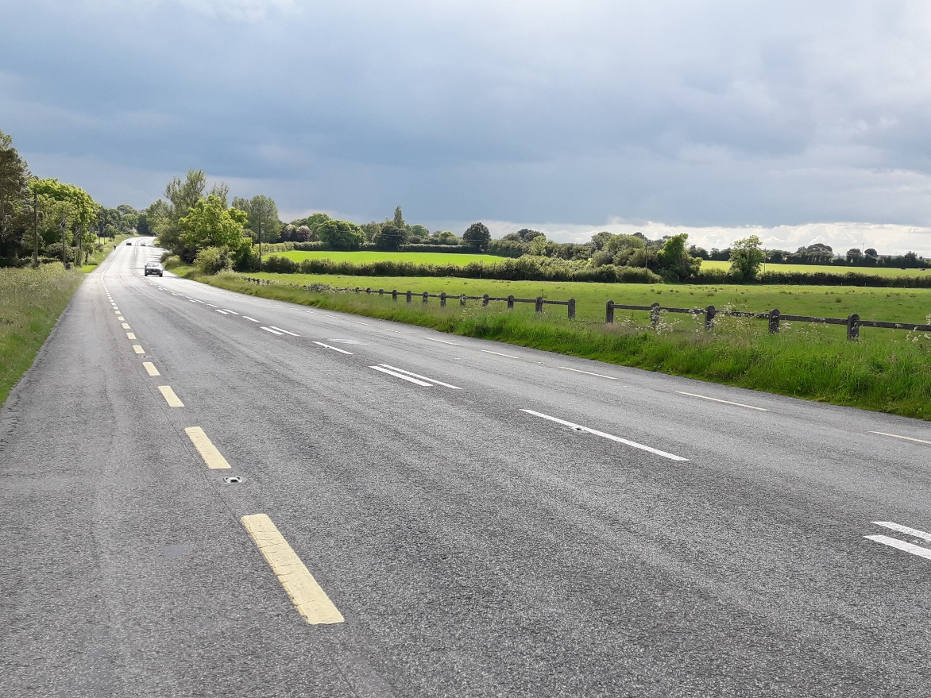
Background (Kilkenny Co. Co.)
Approximately 30km of Concrete/Timber Post and Rail fencing identified
Broken in 234 sites with 172 individual landowners
Works broken into 4 stages;
  Site Identification & Assessment
  TII Submission
  Tendering
  Works & Closeout
To Date;
  2021 – c.1.5km 2No. Contracts
  2020 – c.2km 3No.Contracts
  2019 – c1.1km 3No. Contracts

Slide 3
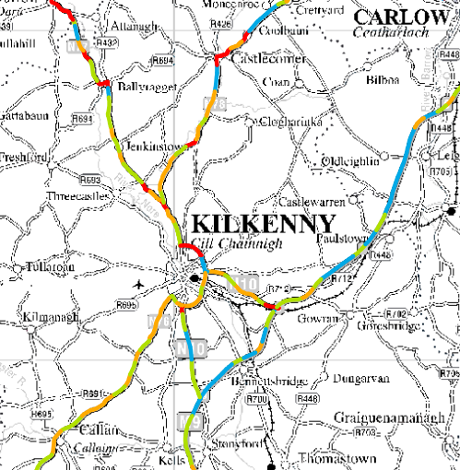
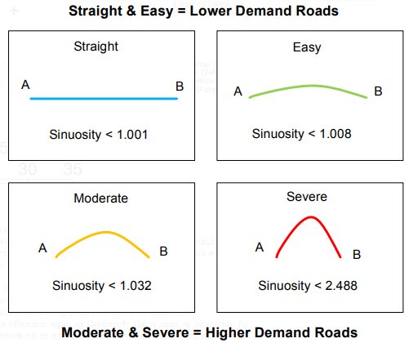
1.Site Identification & Assessment
TII Excel Site template for each site;
  On site measurements;
  Photos
  Sinuosity Map
  Other hazards (trees, lighting columns etc.)
  Landowner negotiation
    Land Direct
    On site meetings
    Area Engineer & General Site Supervisors for Contact details

Slide 4
2. TII Submission
TII Report Template;
  Predominately extracts from TII Site Excel Template
  Submissions with sites within close proximity of one another if possible
  Provide Cost Estimate based on rates from previous works
  Recommend submissions with cost estimates of <€50k

Slide 5
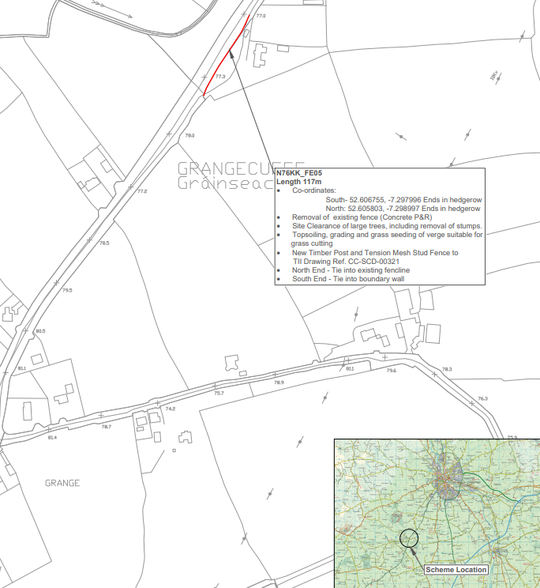
3. Tendering
Tenders with estimates below €50k;
  Request quotes from 3+ contractors including;
    Cover Letter
    Drawing of proposed works ->
    TII Pricing Document Template
    Standards & Construction Details
    Draft Letter of Intent for lowest tenderer to confirm works completed by particular date
Tender Assessment and Award Recommendation

Slide 6
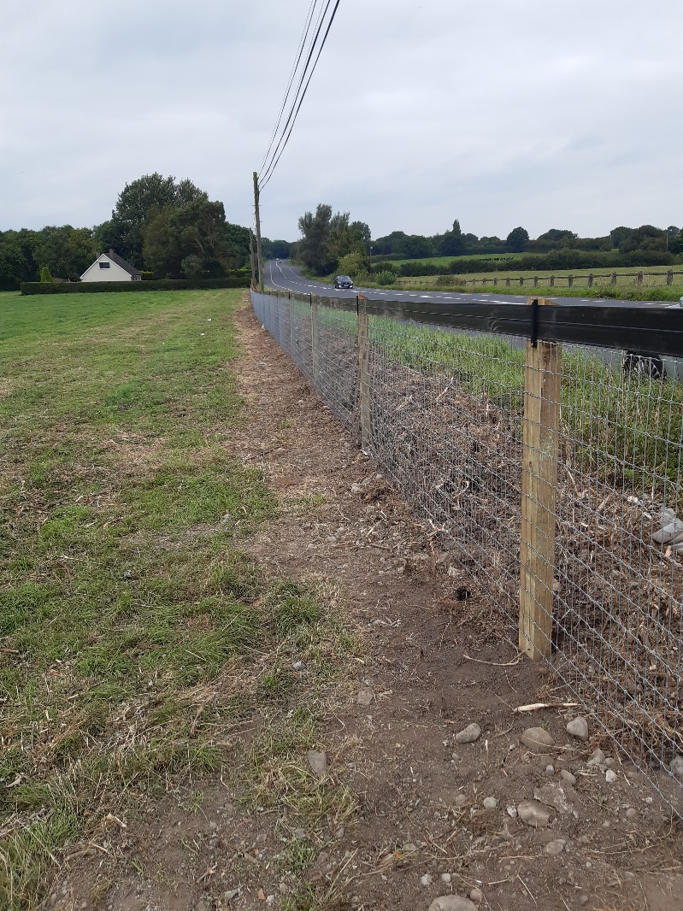
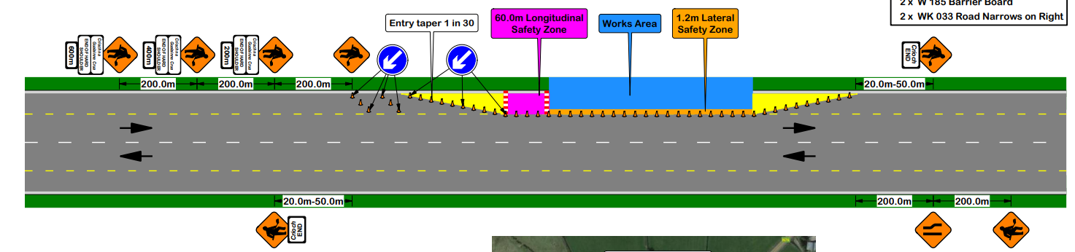
4. Works & Closeout
Ensure TTM arrangements submitted and reviewed in advance of works
Material datasheets, tax clearance and insurances required also
Site visits
  Initial TTM setup and check;
  Weekly site visits;
  Snagging with TII rep. if possible.
Supplier set up if required
PO generation with finance section
Once snagging complete invoices paid

Slide 7
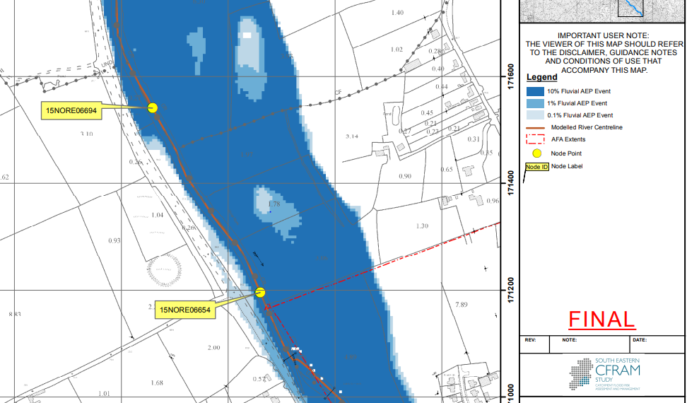
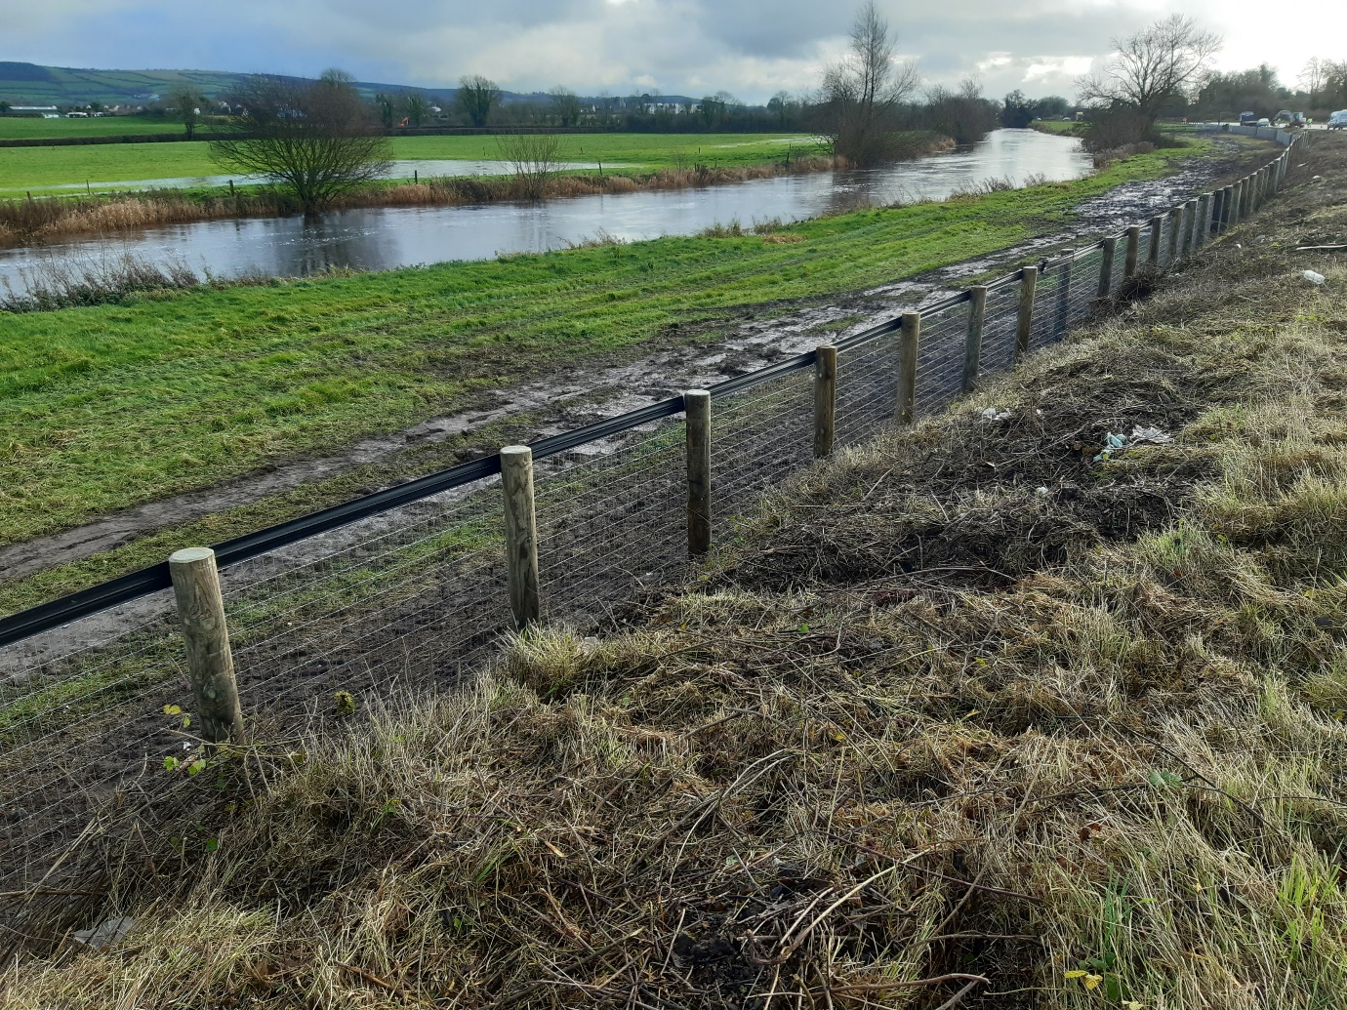
TII Standard - CC-SCD-00321 - Fencing - Timber Post and Tension Mesh Stud Fence. Note 16

Slide 8
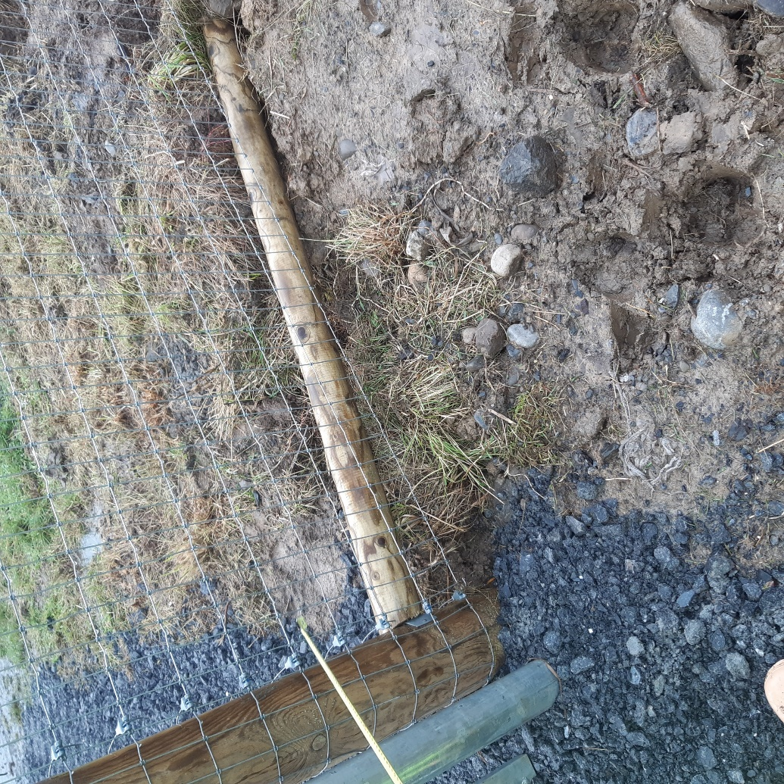
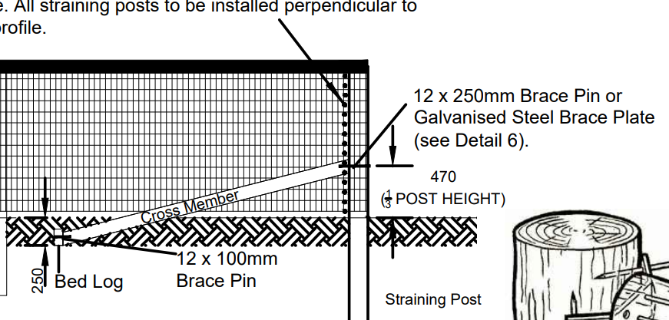
TII Standard - CC-SCD-00321 - Fencing - Timber Post and Tension Mesh Stud Fence

Slide 9
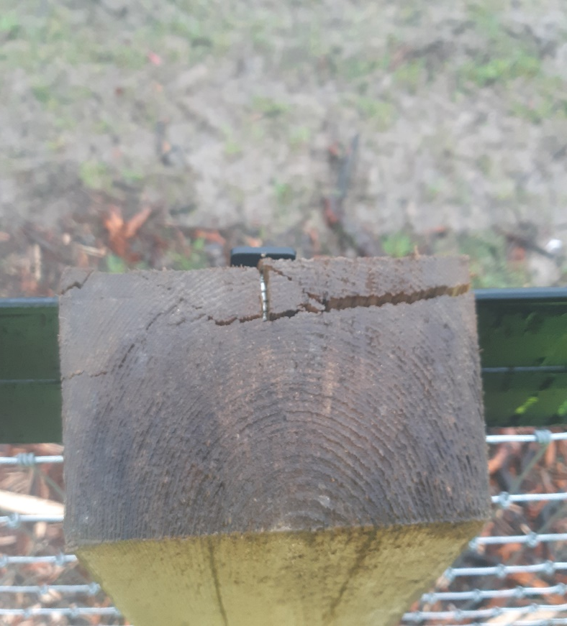
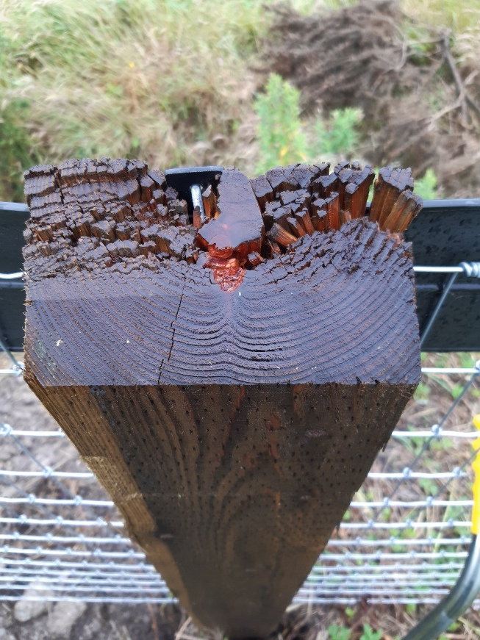
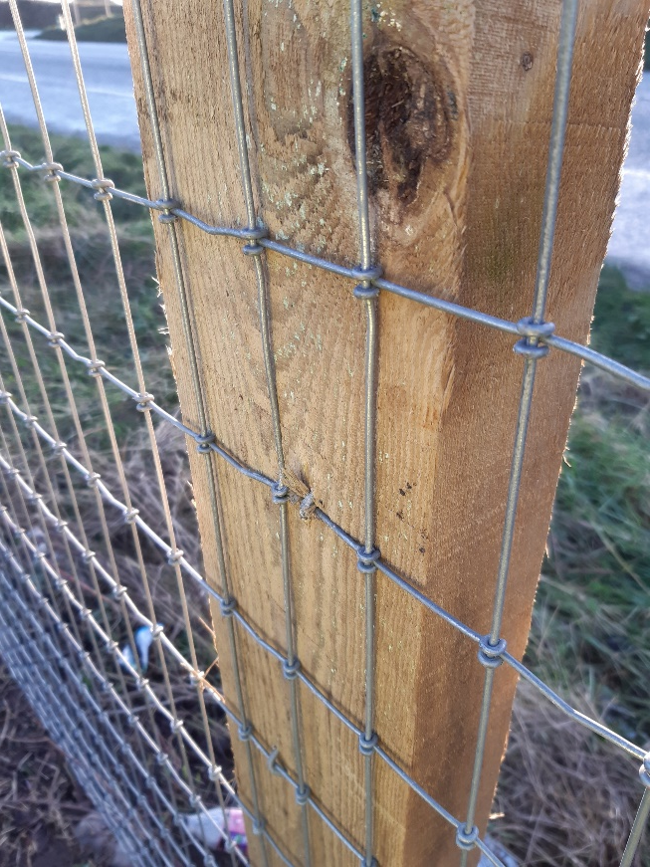
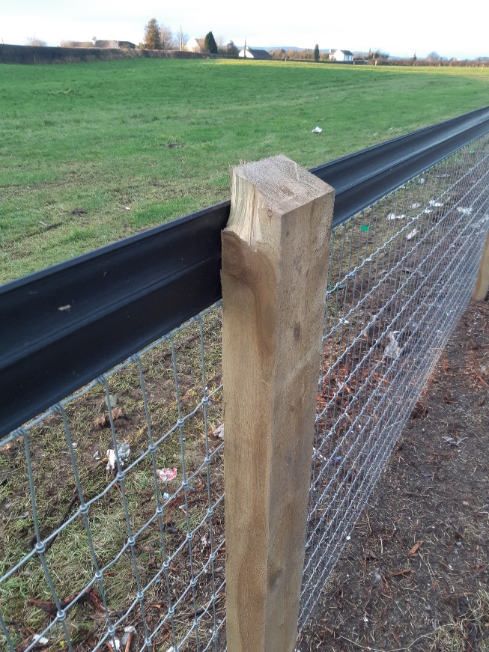
Damage Posts allowing water ingress and imbedded staples

Slide 10
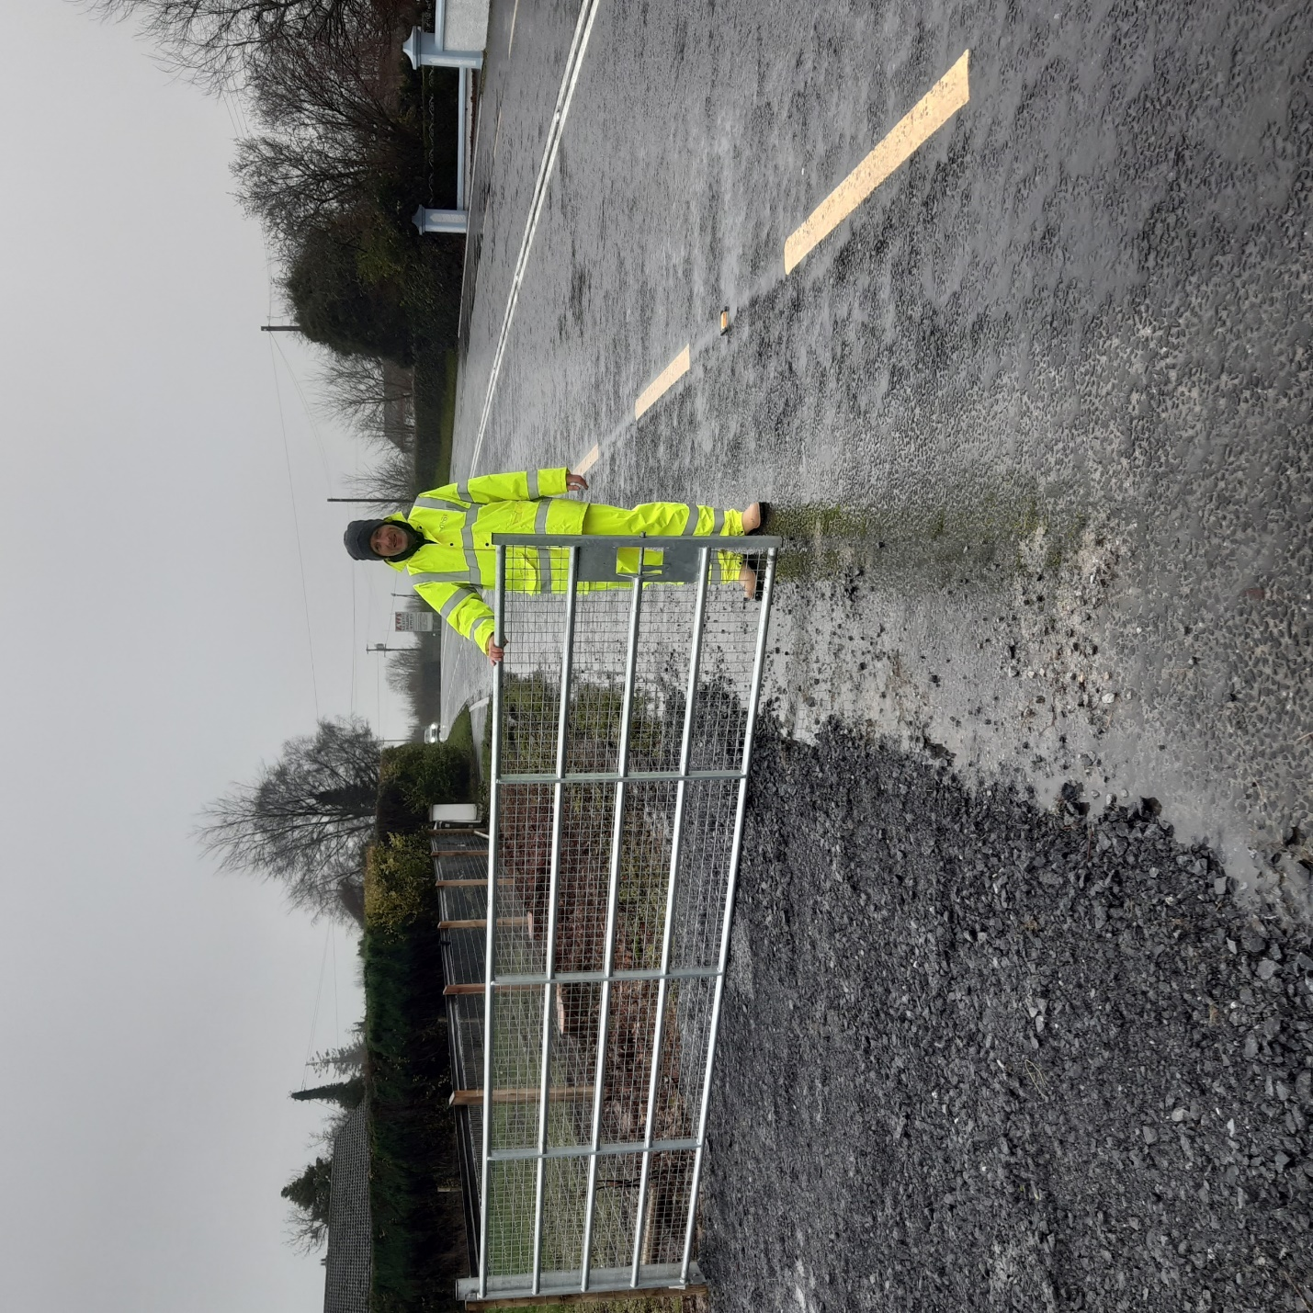

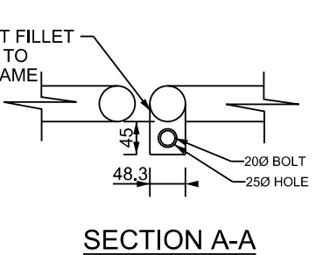
TII Standard -
CC-SCD-00310 - Gates - Steel Double Field Gate
CC-SCD-00309 - Gates - Steel Single Field Gate

Slide 11
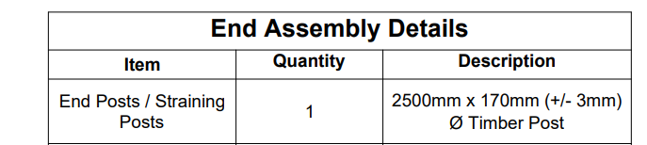
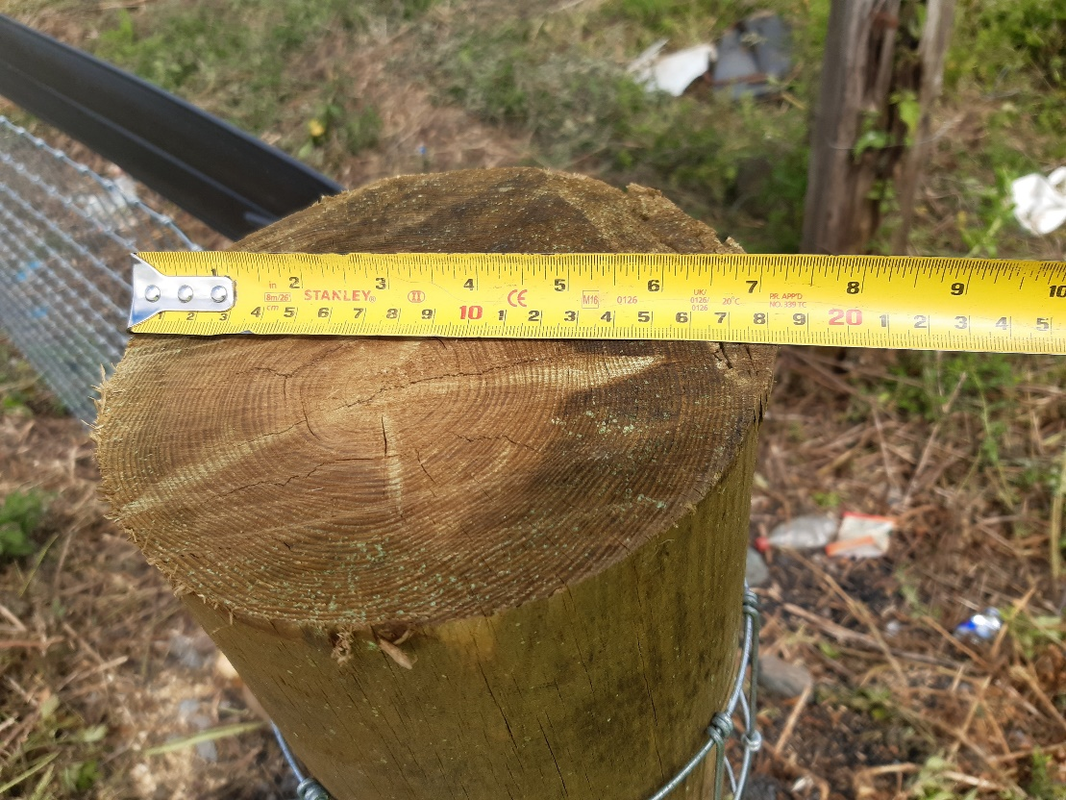
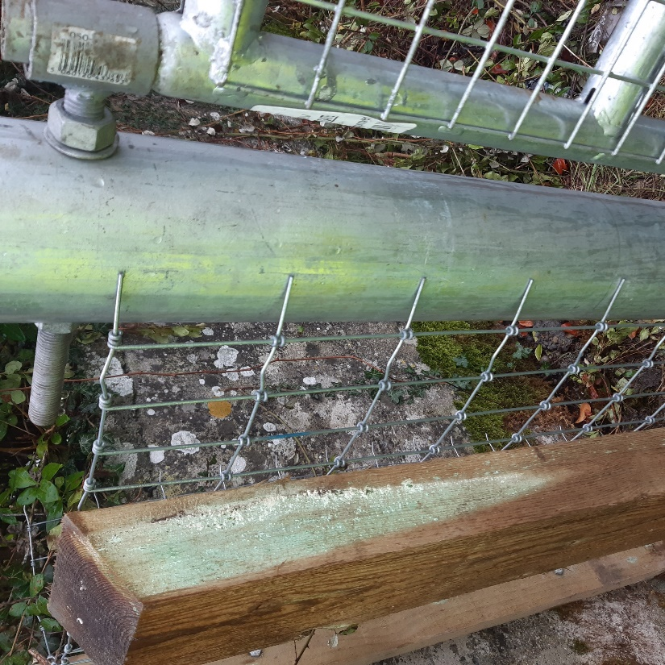
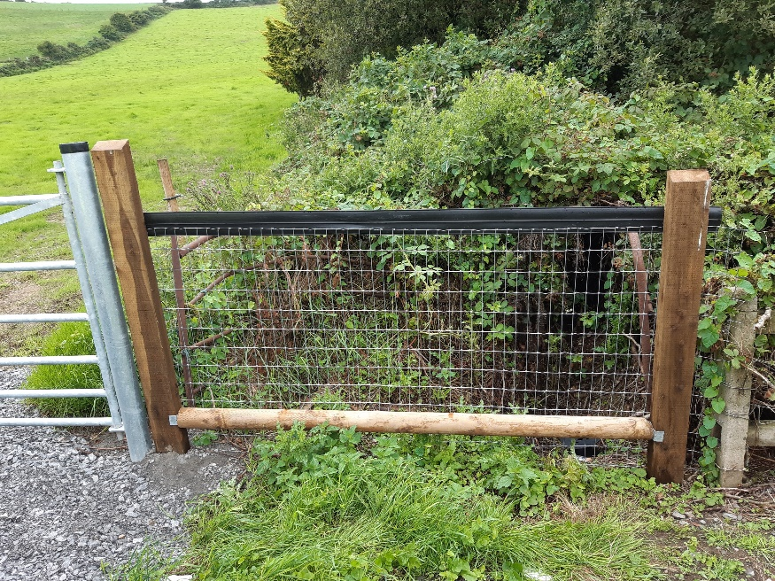

Slide 12
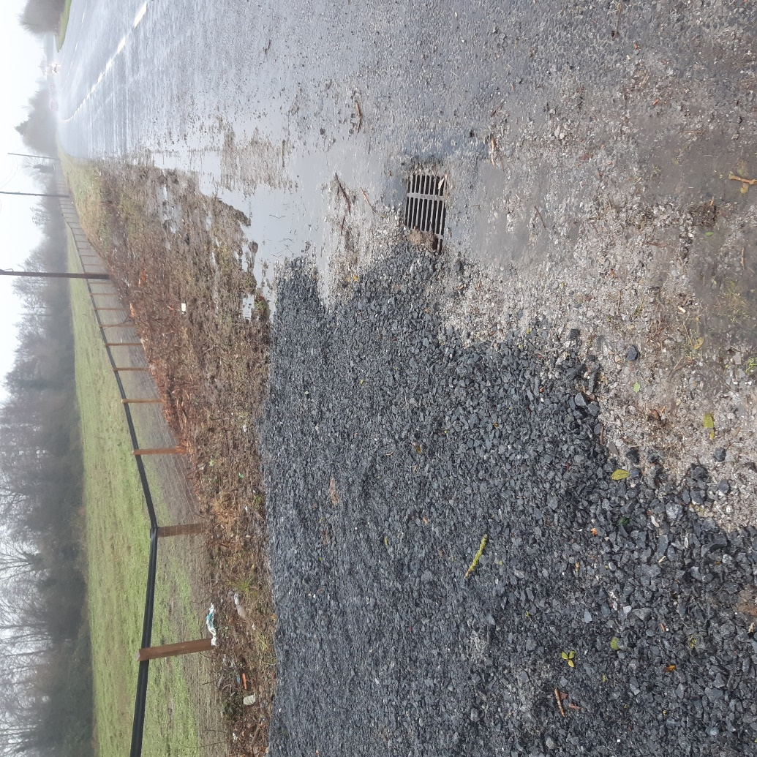
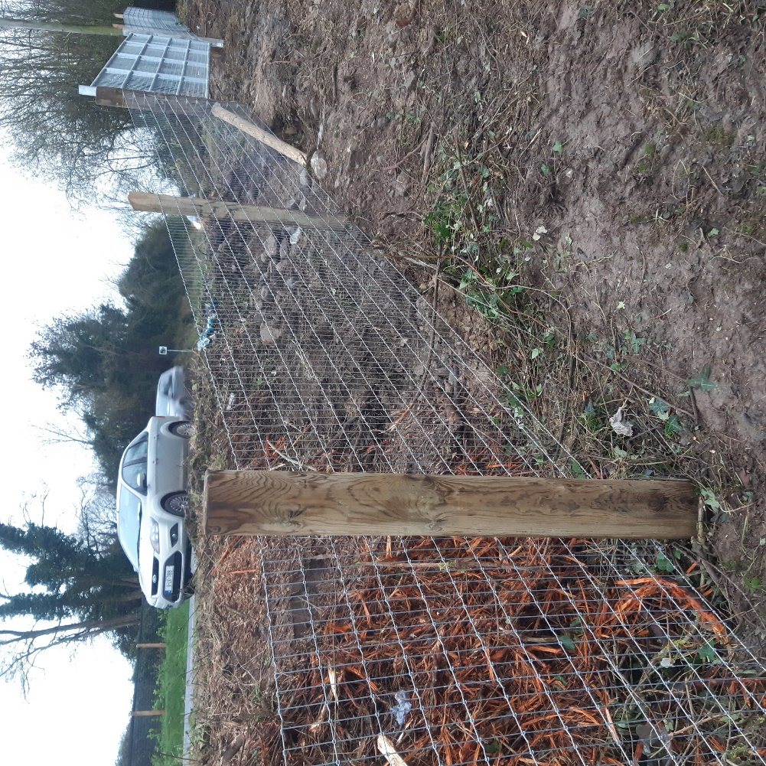
Change in vertical alignment greater than 4 degrees.
Seperate mesh fencing should be provided either side of strainer and tensioned.
This would reduce the risk of uplift and pressure on staples

Slide 13
Other Common Snag items
Posts protruding more than 1400mm above ground level. No cutting off of Post heads
Where trees/bushes are removed, the stumps are to be removed or ground down to below ground level.
Loose ends on gripples (animals may harm themselves)
Maximum gap of 100mm is maintained between the mesh and ground level (recommended 50mm)
Where fencing provided between two lands, straining post provided at boundary

Slide 14
Thank you for your attention
Any Questions?

