Slide 1
TII Road Safety Seminar
9th of April 2025,
Athlone.
Age Friendly Active Travel
Ruth Van Ry, Evaluation Manager, Sustrans
ruth.vanry@sustrans.org.uk

Slide 2
Project background
Sustrans
Context
We are a UK and Ireland based charity who work for and with communities, helping them come to life by walking, wheeling and cycling to create healthier places and happier lives for everyone. We're the custodian of the UK National Cycle Network – a network of over 12,000 miles of signed paths and routes for walking, wheeling, cycling and exploring outdoors.
The Research and Monitoring Unit (RMU) is a team of research, evaluation and GIS specialists. We make the case for walking and cycling by providing transparent and authoritative evidence, which influences and shapes policy, practice and investment.
As the population of Ireland has steadily been getting older since the 1980s, ensuring the provision of ‘age friendly’ active travel infrastructure is an important part of the success of the planned NCN
15% of the general population were aged 65 or over in 2022 compared to a projected 23% of the population in 2042 .
The development of a national-scale cycle network has taken on greater significance in the context of the Climate Action Plan (2023), which calls for a significant reduction in transport emissions by 2030 with measures aimed at enabling 500,000 extra walking, cycling and public transport journeys per day.

Slide 3
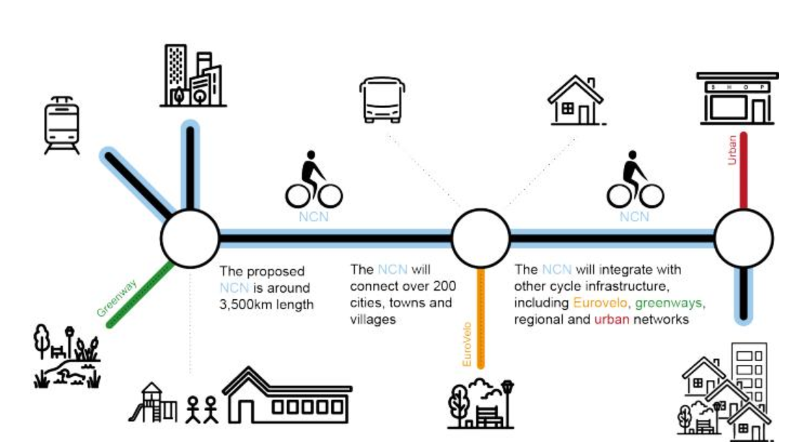
Transport Infrastructure Ireland
In 2021 TII, on behalf of the Department of Transport, initiated a project to develop a plan for a new National Cycle Network (NCN). This research was commissioned by TII to inform the future delivery the NCN.
The National Cycle Network will see 3,500km of safe bike corridors, connecting 2.8m people in cities and towns. Plan published by DoT in January 2024 (www.gov.ie)
The NCN will be composed of 85 corridors, integrating existing and planned greenways and other cycling infrastructure, as well as an extensive new network of safe cycle routes along existing roads.

Slide 4
Research| Aims and Phases
Aims - To identify factors, specific to age 55+ that will:
Make walking, wheeling and cycling more accessible and enjoyable
Improve the safety of people walking, wheeling and cycling
Phases -
Literature Review An evidence review of the key design and infrastructure guidance and literature available on age friendly active travel nationally and internationally
Survey 414 people aged 55 and over living in Ireland completed an online survey. 30 of the survey respondents took part in a follow-up interviews
Consultation Survey of 22 professionals and interviews with 16
Workshop – With 11 professionals examining processes, standards, gaps and suggesting improvements

Slide 5
Literature Review| Key findings
• Separated active travel routes (from motor traffic) increases safety and perceived safety amongst older people.
• The quality (and maintenance) of surfaces is important for older people
• Design and infrastructure features which are important are:
- frequent seating,
- better lighting and
- distinct surface materials and colours
• Active travel links to public transport are especially important for older people in rural areas, who may rely on public transport for longer journeys, but struggle to reach facilities such as bus stops and train stations due to a lack of adequate active travel infrastructure
• Other important factors include:
- reducing speed limits
- increasing crossing times on signalised crossings
- introducing low traffic neighbourhoods and modal filters to reduce motor vehicle traffic

Slide 6
Literature Review| Summary of Gaps
Design Guidance - Much of the literature initially identified was focussed on the behaviour change and modal shift aspect of age friendly active travel, whereas age friendly active travel design and infrastructure is less visible.
Rural context - more rural-specific studies could be carried out. Presently much of the literature is focussed on car-dependency and public transport for older people in rural areas, as opposed to active travel.
Mobility scooters - Little research has been conducted into different modes of active travel that are especially relevant to older people, such as mobility scooters within the built environment and infrastructure context. There are currently very few studies focussing on making infrastructure safer for mobility scooter users.

Slide 7
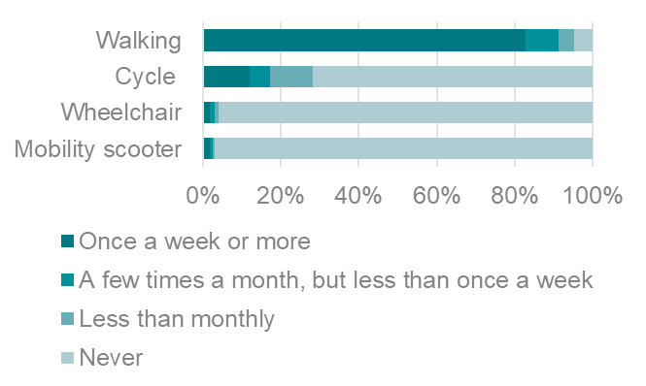
Stakeholder Engagement | Behaviours
The online survey was designed and administered in May and June 2023. A link to the survey was sent to Age Friendly Ireland and then distributed amongst the National Network Structure of Older People’s Councils and Age Friendly Programme Managers for dissemination throughout their local networks.
414 people aged 55+ replied to the survey.
Active travel behaviours:
Notes:
Walking 82.6 8.5 4.1 4.8
Cycle 12.1 5.1 10.9 72.0
Wheelchair 1.9 1.2 1.0 95.9
Mobility scooter 1.7 0.7 0.7 96.9
Cycle some of the time 116 (28%)
Cycle Never 298 (72%)

Slide 8
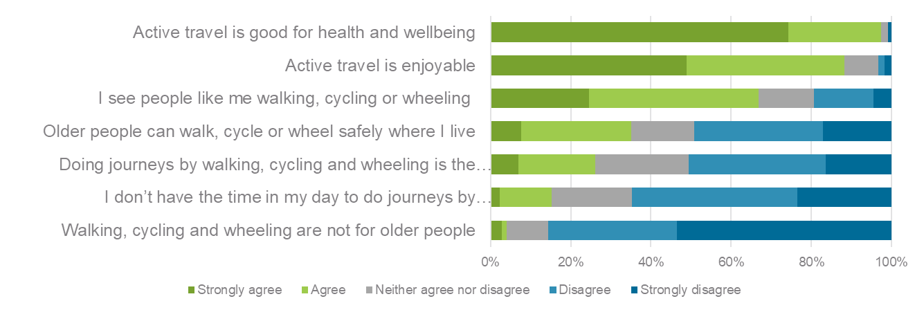
Stakeholder Engagement| Attitudes to active travel
Those who live in rural locations are more likely than those in urban locations to agree that they don’t have the time in their day for active travel, and less likely to agree that active travel is the norm where they live
Notes:
Women are more likely than men to agree that they don’t have time in their day to do active travel
Those who live in rural locations are more likely than those in urban locations to agree that they don’t have the time in their day for active travel and that active travel is not for older people
Car Travel was identified as more desirable in rural areas as opposed to active travel, mainly based on lack of Public Transport

Slide 9
Stakeholder Engagement| Safety
What would make you feel safer to travel actively | %
Regular maintenance of pavement and cycle routes to keep them free of weeds, potholes etc. | 55
Well-lit cycling and walking routes | 49
Clear separation of cycle lanes / footpaths from motorised vehicles | 45
Fewer obstacles on pavements or cycle lanes, such as shop signs, bins, parked cars etc. | 42
More safe crossing places | 42
More separation between cyclists and pedestrians on cycle routes or footpaths | 42
Traffic calming measures on roads | 39
More routes through areas where traffic is restricted | 36
Wider cycle lanes / pavements | 33
Longer time allowed to cross at pedestrian and cyclist crossings | 30
Quotes:
“There is some really good segregated cycle infrastructure, but it's not yet connected”
“I've noticed that the crossing time on pedestrian lights is too b***** fast”
“we care more about the cars than the pedestrians which is a shame”
“There is no bus stop near to me so to get to shops I have to use a car”
“Cycle infrastructure stops and then blends with the pedestrian footpaths. It's kind of unclear”

Slide 10
Rural areas and their challenges
32% of those living in rural areas would be encouraged to travel actively more often if they were able to combine walking, cycling and wheeling with public transport more easily
Just over three in ten people in Ireland (31.4%) live in a rural area.
Very remote and rural areas in Ireland have the highest average age, compared to other more urban areas, and the fastest aging population
Based on out stakeholder survey, those who live in rural areas are more likely than those in urban areas to be deterred from active travel by places being too far away
Our professionals felt that rural areas are inhospitable for active travel and challenging to find opportunities to make improvements to

Slide 11
Consultation with the professionals| Gaps identified
There was a good deal of overlap in the areas identified by older people as important for them to feel safe when traveling activity, and principals being delivered by the professionals we consulted. However, there were also some gaps identified:
Greenways were spoken of positively but creating a network of routes to connect villages with towns and cities was identified as a gap in current delivery
Older people not being specifically designed for, but expected to have been accounted for through a broader inclusive approach
Seating and rest areas are seen as important but can be a challenge to deliver
Not aware of guidance that specifically considered mobility scooters - most said that there isn’t an accessibility specialist that they work with
The provision of toilets, which are valued by older people, had only been delivered by a small proportion of professionals engaged in this consultation
.

Slide 12
Design workshop| Guidance needs identified
Priority guidance improvements identified in the workshop:
Tactile paving guidance – particularly for complex areas
Policy around responsiveness of pedestrian crossings
Seating designs, location and quality guidance
Standard designs for continuous footways and crossings
Review of standards through an Age Friendly Ireland perspective
Specific guidance for rural roads/lanes
Public lighting guidance – it was discussed that in particular the balance between ecology and making routes accessible is hard to navigate
When engaging with stakeholders a lack of availability of local groups can be a barrier, as well as a lack of formalisation around this process.

Slide 13
Recommendations:
42% of survey respondents said unsafe roads deter them from travelling actively
Separation of active travel modes from traffic is clearly a preference
Poor surface quality on existing active travel routes is also a deterrent
Recommendations
Encourage the continued delivery of high-standard separated active travel routes, lighting and high quality, even surfaces
Review where the remit for route maintenance lies and ensure that route maintenance is conducted to prevent a safety risk from trips or falls

Slide 14
Accessible infrastructure
Our review of literature highlights that the relationship between mobility scooter usage and the built environment is an under researched topic
Our consultation with professionals found that none are aware of design guidance that specifically considered mobility scooter users as a distinct group
Active travel design practitioners also felt that there was a lack of data around the general levels of mobility scooter usage and how this user group uses the existing infrastructure
Recommendations
Better understanding required of the mobility needs of the older age group
Barriers on routes need to be identified and removed
Greater awareness/creation of design guidance for mobility scooter and wheelchair users.

Slide 15
Providing toilets and rest places
53% of our survey respondents said they would be encouraged to travel actively more often if there were more toilets
41% of our survey respondents said more seating at regular intervals was important.
Although most of our active travel design practitioners had considered benches in their planning very few had designed features for public toilets
The active travel design practitioners consulted did not have clear guidance or policies on how to deliver toilets
Recommendations
Provision of toilets needs to be included in design guidance
Better collaboration between those designing routes and those delivering public toilets is required
The inclusion of seating and shelters should not be overlooked or sidelined

Slide 16
Data collection, identification of needs and evidence of impact
Our consultation with active travel design practitioners found very few examples of tools or processes that are specifically focused on the needs or experience of older people
None of our practitioners were aware of auditing tools that specifically focused on the needs of older people
There were very few mentions of key performance indicators that relate to age-friendliness
Recommendations
Guidance is needed on how to identify where provision for older people is a priority
Highlight/create specific relevant auditing tools in guidance which considers the older route user
Produce guidance on route monitoring and evaluation in relation to older people
Establish standardised KPIs at local and national levels which focus on the older route user

Slide 17
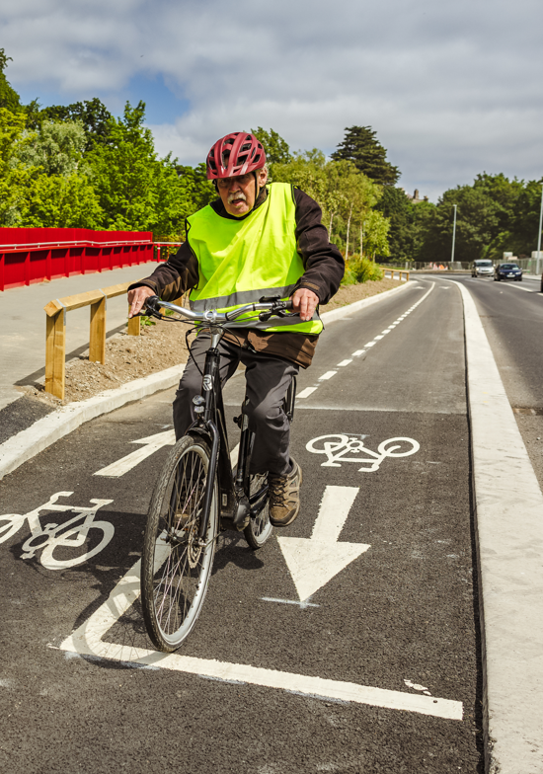
Support those delivering active travel infrastructure
Clear consistent guidance at a national level, and sign posting and training sessions for that guidance, would aid the planning and design of age friendly active travel:
Provide specific funding, and guidance, to support consultation with older people
Build a broad repository of case studies that is accessible to practitioners and additionally rural context cases studies
Review of tactile paving guidance (varied and unclear currently)
Greater cross departmental collaboration and consultation with age friendly groups would improve the planning and delivery of routes that support active travel by older people.
Review guidance around multi-disciplinary team working, to ensure there is sufficient information about the different types of roles that would ideally be consulted in the development of a scheme.

Slide 18
Thank you for your attention! Full reports are due later in 2025 - Age Friendly Active Travel - Empowering Women to Cycle
info@tii.ie
https://www.tii.ie/en/tii-library/research/
monitoring@sustrans.org.uk
https://www.sustrans.org.uk/for-professionals/research-monitoring-and-evaluation/

