Slide 1
Casualty trends in Ireland, and research on recent speed limit change
TII Conference, 9Th April 2025
Velma Burns, Research Manager
Road Safety Authority

Slide 2
Presentation outline
Fatality and serious injury trends
Irish research on speeding
Overview of 2024 survey of motorists on reduction in speed limit on rural local roads

Slide 3
Long term trend fatalities
RSS 2030 Target
72
Figures for 2021 to 2024 are provisional and subject to change
Notes:
Recent monthly averages:
2024: 14 fatalities
2023: 15 fatalities
2022: 13 fatalities
2021: 11 fatalities
2020: 12 fatalities
2019: 12 fatalities
2018: 11 fatalities
2024 Target 122

Slide 4
Road fatalities in Europe, deaths per million 2024
Ireland (32 dpm) is placed 6th in the EU-27 behind Sweden (20 dpm), Malta (21 dpm), Denmark (24 dpm), Luxemburg (27dpm), Netherlands, Finland (both 31 dpm)
EU member state
Non EU member state
Source: European Commission 2025. Figures for Belgium and Portugal are each based on data for the first six months.

Slide 5
Steady growth in population, vehicles and licences equals greater risk exposure
Between 2009 and 2023, increases have been seen in:
Driving licences held (+29%)
Vehicle population (+20%)
Population estimates (+17%)
Vehicle kilometres travelled (+5%)
100

Slide 6
Overview of provisional fatality and serious injury data

Slide 7
Road user profile of the last five years
Driver, passenger and pedal cyclist fatalities are highest in last 5 years.
42% of fatalities
Of fatalities in 2024, three in four (74% , 127) were male and quarter (26%, 45) were female.
Figures for 2021 to 2024 are provisional and subject to change

Slide 8
Age profile of the last five years
In 2024, the highest risk age group was those aged 16-25 years (28%).
Figures for 2021 to 2024 are provisional and subject to change. Age currently unknown for one 2024 fatality at present.
Notes:
35% of all fatalities aged <26

Slide 9
Fatalities by road type over the past five years
Deaths on National roads highest in 2024 compared to the previous 4 years
Compared to 2020
24% increase
36% increase
6% increase
No change
Between 2020 and 2024, approximately 7 in 10 fatalities and 1 in 2 serious injuries occurred on rural roads with a speed limit of 80 km/h or greater
Figures are provisional and subject to change. ​Road Type unknown for 2 fatalities in 2020, for 8 fatalities in 2023, and for 3 fatalities in 2024.
Notes:
7 in 10 happen on higher speed roads
Overall, 14% of fatalities occurred on Local Rural roads over this time period.
12% of serious injuries occurred on Local Rural roads.

Slide 10
Long term trend serious injuries
Provisional data indicates 8 serious injuries for every fatality in 2024, but numbers will rise.
*2021-2024 serious injury data is provisional and subject to change. There can be significant fluctuations in serious injury numbers until such time as records are fully updated.

Slide 11
Provisional data on serious injuries 2024
Road user type (n=1,368)
Rural and urban roads
Notes:
Dotted lines, should be part of 2
RU type actual, vertical bars across, actual figures age same

Slide 12
Speeding
From observational studies, self-report surveys and coronial data

Slide 13
Speeding – research results
Coronial data 2016 – 2020 Driver fatalities with a record of their action(s) (N=313)
Up to 10 actions can be recorded per driver fatality.
Driver attitude and behaviour surveys 2014 – 2024 % (N=1,000+)
At least sometimes, self-report speeding
Free speed observation survey 2024 N=3,500 (80 km/h) – 14,800 (120 km/h)
5% reduction in average speed ≈ 20% reduction in fatalities
(WHO, 2023)

Slide 14
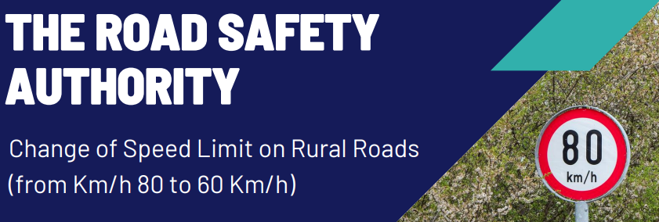
2024 Survey of Motorists on changes to speed limits
In context of Speed Limit Review
Published on https://www.rsa.ie/road-safety/research/reports/safe-speeds
Sample of 1,263 motorists aged 17+
Notes:
The research comprised a nationally representative online survey of 1,263 motorists aged 17+:
Quota controlled in terms of gender, age, region and area.
Fieldwork was conducted in November 2024.

Slide 15
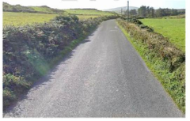
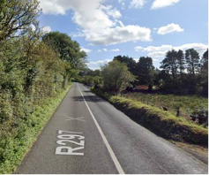
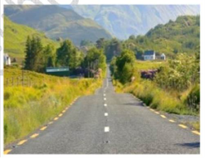
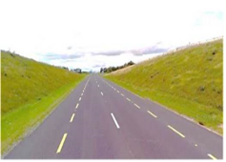
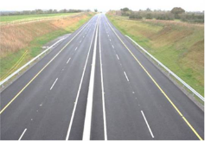
Road type reviews
Motorists asked to indicate the speed limit on each of these roads:
Local road | Regional road | National Secondary road | National Primary road | Motorway
50 or 60 km/h | 70% | 49% | 21% | 33% | 13%
80 km/h | 28% | 50% | 55% | 36% | 14%
100 km/h | 1% | 1% | 24% | 32% | 34%
120 km/h | 0% | 0% | 0% | 1% | 39%
Q.2a We are now going to show you some road types in rural areas, for each of these, can you indicate which you think is the speed limit?
Base: All Motorists N – 1,263
Notes:
The proportion of motorists who correctly identify the speed limit for each road via a photo image is consistently modest; for example, only 28% of motorists correctly identify that the local road image has a speed limit of 80km/h.
70% identified L road speed limit as lower, so not changing fundamentally perception of SL for that road. Future change of National Secondary road from 100 km/h to 80 km/h may not be perceived as a major change as 76% of motorists already believe the speed limit to be 80 or lower.

Slide 16
Perceived Safety of each Road Type
59% of all motorists consider local roads to be ‘unsafe’; far below that associated with the other road types.
Local road | Regional road | National secondary road | National primary road | Motorway
Very unsafe
Unsafe
Neither safe nor unsafe
Safe
Very safe
NET Unsafe | 59% | 37% | 16% | 11% | 10%
Q.3 Now that you have reviewed the characteristic of each road type, how would you rate these roads use in terms of safety as a CAR DRIVER?
Please scale from 1 to 5, where 1 is “very unsafe” and 5 is “very safe”. The numbers in between can be used to refine your response. Base: All Motorists N – 1,263

Slide 17
Overall on local roads…
60% of motorists have some awareness of an upcoming change to the speed limit to local roads
32% of motorists aware of the specific upcoming change from 80 km/h to 60 km/h
63% of all motorists support the reduction of the speed limit from 80 km/h to 60 km/h, with 16% objecting
Acceptability of speeding on 80 km/h roads in general
Q.2a We are now going to show you some road types in rural areas, for each of these, can you indicate which you think is the speed limit? Base: All Motorists N – 1,263

Slide 18
Reasons for speeding – Local roads
Familiarity with local roads is the key rationale provided by those who speed on these roads.
I am familiar with these roads and can drive like this safely
I am a skilled driver and can drive like this safely
Speed limits on some 80 km/h roads are too low
Unlikely to come across other road users
I am usually in a hurry when using these roads
There is little risk of a collision on these roads
Unlikely to be detected by Gardai
Lapse in concentration
Other drivers drive too slowly on these roads
Speed at least sometimes
28%
Q. 5b You indicated that you speed, at least sometimes, on local roads, which of the following would you say are reason(s) you speed on these roads? Base: Speed very often – sometimes on local roads N – 349
Notes:
23% exceed 80 km/h speed limits on local roads by less than 10 km/h at least sometimes.
18% exceed 80 km/h speed limits on local roads by more than 10 km/h at least sometimes.

Slide 19
Local Roads Speed Limits: Reasons for Support for Change (60 kmph)
There is a perception that most users drive too fast on these roads, and that there are too many sharp bends.
Most people drive too fast for the conditions on these roads
There are too many sharp bends on these roads to travel at 80 km/h
Lower speed limits will improve road safety
Slower speed makes streets safer for all users
Safety for children, cyclists, pedestrians
Lower speed limits will result in fewer injuries collisions and crashes
Other
Any Support
63%
Q.10a You previously indicated you support the speed limit reductions on local roads, which is the main reason for this? Select one option only.
Q.10b And are there any other reasons? Please select all that apply. Base: All Motorists supporting speed limit reductions on local roads N – 793

Slide 20
Local Roads Speed Limits Change (60km/h) – Likely Driver Changes
73% of motorists indicate that they will drive within the new speed limit on local roads; similarly, 65% indicate they will drive slower than they currently do on local roads.
Summary Likely
I will drive within the new speed limit
I will drive slower than I currently do on these roads
Pedestrians and cyclists will be safer when using these roads
There will be fewer collisions on these roads
There will be more drivers receiving penalty points for speeding
Other drivers will drive slower than they currently do on these roads
Other drivers will find alternative routes to avoid these roads
Journey times will not change
Other drivers will drive within the new speed limit
I will find alternative routes to avoid these roads
Q.9 When speed limits on local roads are changed to 60 km/h, how likely or unlikely do you think it would be that…..?
Base: All Motorists N – 1,263

Slide 21
Conclusion
Change of speed limits survey will be repeated later this year to monitor attitudes and behaviour
The RSA will collaborate with TII and DoT regarding similar research around future changes
Using the Safe System approach, we need to support drivers to comply with speed limits through
Education
Enforcement
Infrastructure
Stakeholder Collaboration

Slide 22
Thank you vburns@rsa.ie

Slide 23
Fatalities and serious injuries on local rural roads
2020 - 2024
Percentage by road user
Overall, 14% of fatalities occurred on Local Rural roads over this time period.
12% of serious injuries occurred on Local Rural roads.

