Slide 1
Research and Standards Section
Esther Madden - 9th April 2025
Insert Picture Here
TII Road Safety Seminar - Athlone​

Slide 2
The Research and Standards Section
  Maintains and manages the update of TII standards and technical documents on National Roads
  Works with TII technical experts to determine the need for new documents or updates to existing ones
  These standards and technical documents are used by TII, National Roads Offices, project offices, local authorities, technical advisors, and contractors

Slide 3
Why TII set Standards
Reminder of importance of standards
TII has authority to provide standards for National Roads and this is defined under the Roads Act 1993 as amended
The importance of setting and adhering to TII standards ensures quality, safety, and consistency for the national road network

Slide 4
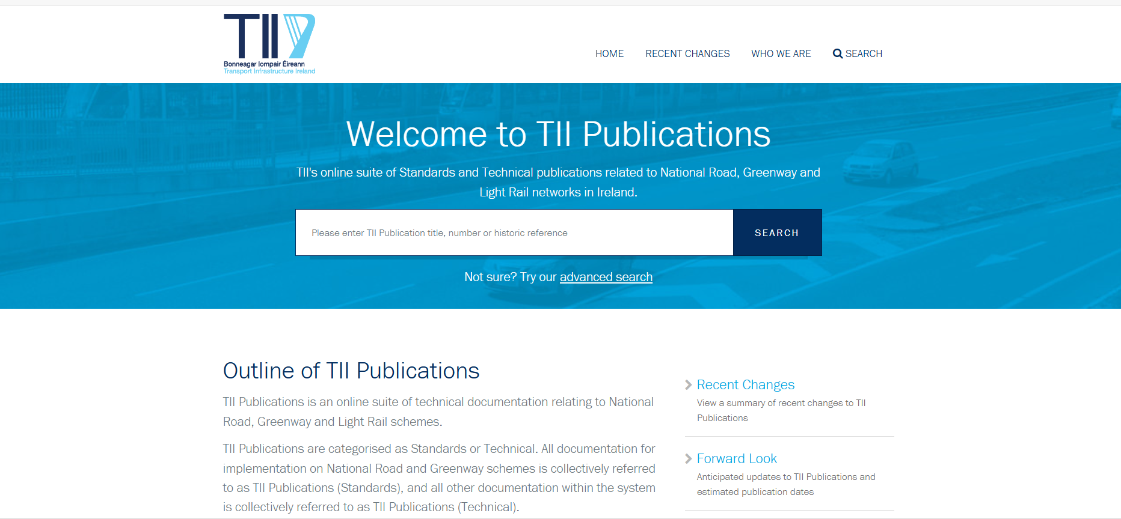
Location of Standards and Technical Documents
Publications 4 times/year
Queries on publications
Email infoPUBS@tii.ie
Annual Roadshow outlining updates
June 2025

Slide 5

Departures from standards
May mean any of the following:
a) The use of technical design standards and/or specifications other than those in TII Standards;
b) The use of a set of requirements or additional criteria for any aspect of the works for which requirements are not defined in the Specification or Requirements for Measurement and Pricing;
c) The use of a technical design standard or specification in a manner or circumstance which is not permitted or provided for in such directive or specification;
d) The use of a combination of Relaxations as set out in the relevant Standards;
e) A combination of any of the above.
Must email infoDEPS@tii.ie to register and submit a departure

Slide 6
Standards Commission
Technical advice is provided via the standards commission which is renewed every 4-6 years​
Oversight provided by Standards Steering Committee
  Department of Transport
  National Road Offices
  Local Authorities
  Transport Infrastructure Ireland

Slide 7
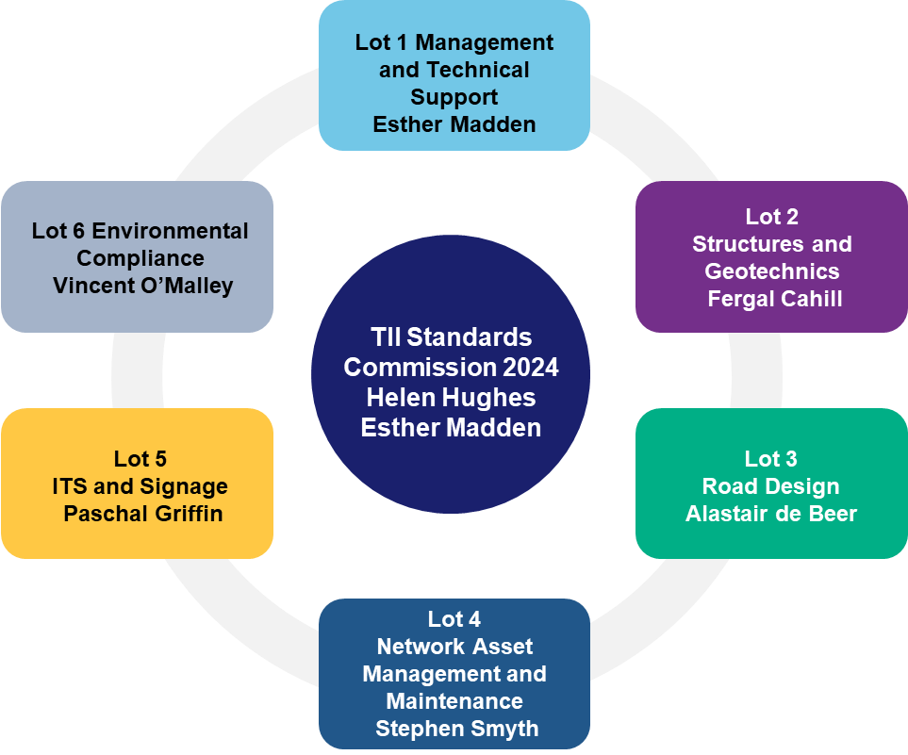
Current Commission 2024 - 2028
Lot 1 Management and Technical Support
Lots 1, 2, 3, 5 and 6 provided by Arup
Lot 4 provided by Aecom/ROD
Lot 6 Environmental Compliance
Lot 2 Structures and Geotechnics
Lot 5 ITS and Communications
Lot 3 Road Design, Drainage and Safety
Lot 4 Network Asset Management and Maintenance

Slide 8
Commission Structure Example
Head of Research and Standards
6 weekly meetings to agree tasks with all lot leaders
Lot Leaders
Work Package Leaders
Task Leaders
Work Package 3.1 Management
Task Agreements
Work Package 3.2 Geometric Design
Task Agreements
Lot 3 Road Design
Work Package 3.3 Road Safety
Task Agreements
Work Package 3.4 Vehicle Restraint Systems
Task Agreements
Work Package 3.5 Road Drainage
Task Agreements

Slide 9
Lot | Topics
1 Management and technical services | Management/ Circular Economy
 | RMP/Works Requirements
 | PMG
 | Innovation
 | Decarbonisation of pavement programme
 | Information management aka BIM
 | Archaeology
2 Structures and Geotechnics | Structures
 | Earthworks
3 Road Design | Geometry/Road safety
 | Drainage
 | Vehicle restraint systems

Slide 10
Lot | Topics
4 Network Asset management and Maintenance | Asset management
 | Pavement Design
5 ITS and Communications | Lighting
 | Traffic manual
 | LUAS lighting
 | ITS
 | Signs and Lines
6 Environmental Compliance | Biodiversity
 | Noise and Air quality
 | Soils/hydrogeology
 | Landscaping

Slide 11
Oversight activities of the commission
Formal progress tracker to manage up to 200 concurring tasks Lot leader meetings to discuss 6-week outlook and potential overlaps/implications Stakeholder engagement plan for each task set at scoping stage e.g. 50% draft, 90% draft SIP/CAP/ABP alignment requested up front and collated for easy reporting Implications reporting and summary at pre-publication meeting

Slide 12

Doc Number xx-xxx-xxxxx
Pre-publication Meeting – Presentation Template
What has changed
Reasons for Update / New Doc
Benefits
What consultation has taken place
Implications on projects
Doc Title
Work Package No. (if applicable)
DD MMM YYYY

Slide 13
Summary of TII Standards and Technical Documents from 2024 contributing to sustainability
Pavement design and maintenance contributing to a circular economy
Updates to the carbon tool user guide and road emissions model contributing to decarbonisation
Update to the cultural heritage impact assessments contributing to social value
Updates to the PAG’s in appraising projects in a more sustainable way
Publication of the research reports of noise monitoring and correction factors contributing to environmental and social actions
New guidelines for soft landscaping in urban transport environments
Updated earthworks guidance and specifications contributing to better use of natural resources
New standard on population and human health contributing to social value

Slide 14

Core themes for 2025 standards and tech documents
Mobility
Safety
Climate

Slide 15
Task alignment with core themes for 2025 standards and tech documents
Mobility infrastructure
Contract docs
Geo Asset management
Drainage
Innovation and data
Safety
Divided roads
Air, noise and water quality
Passive safety of signs
Abnormal loads
Climate
Pavement decarbonisation
Signs and lines trial of sustainable products
Biodiversity

Slide 16
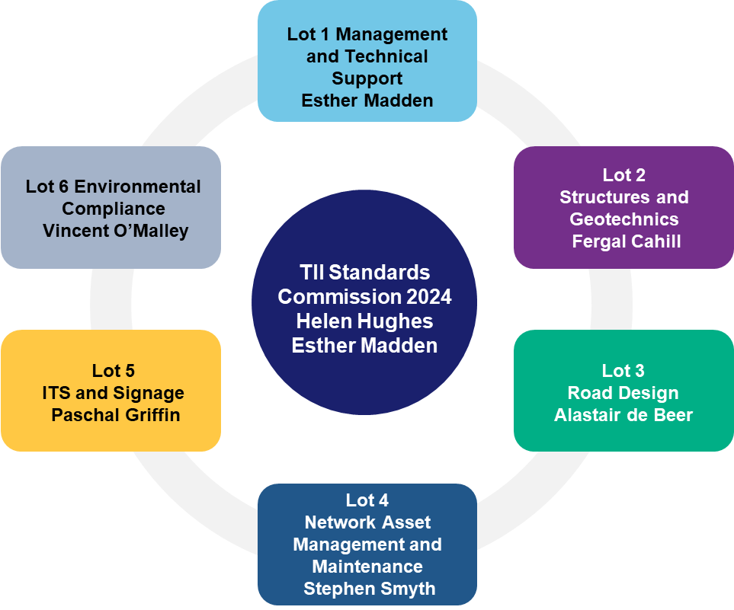
Focus for next 12 months by lot
Innovation
Data Standards
Works Requirements
Abnormal loads
Geo asset management
Biodiversity/soil/landscaping/
water/air quality
Divided roads
Drainage
Ongoing updates of older documents
Passive safety/sustainability of road markings and signs
Training
Decarbonisation

Slide 17
Safety Standards

Slide 19
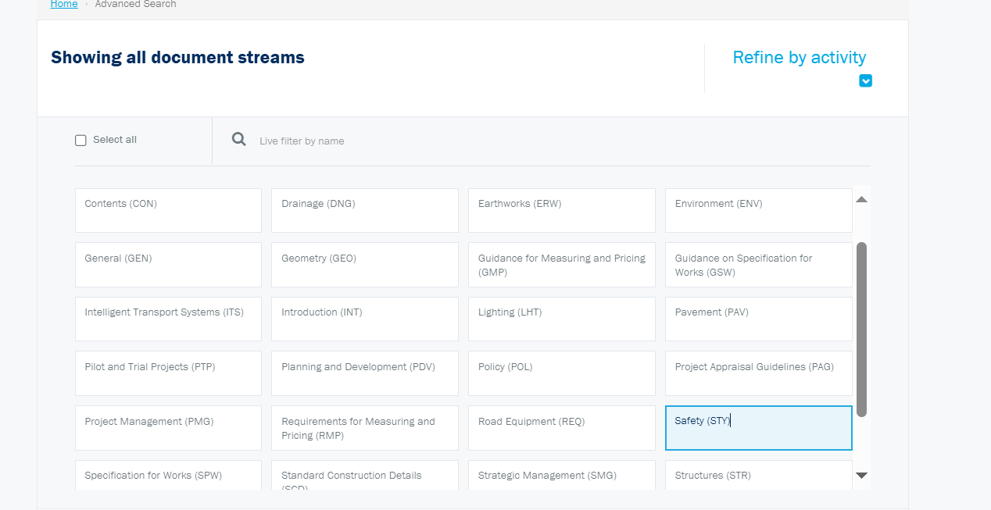

Slide 20
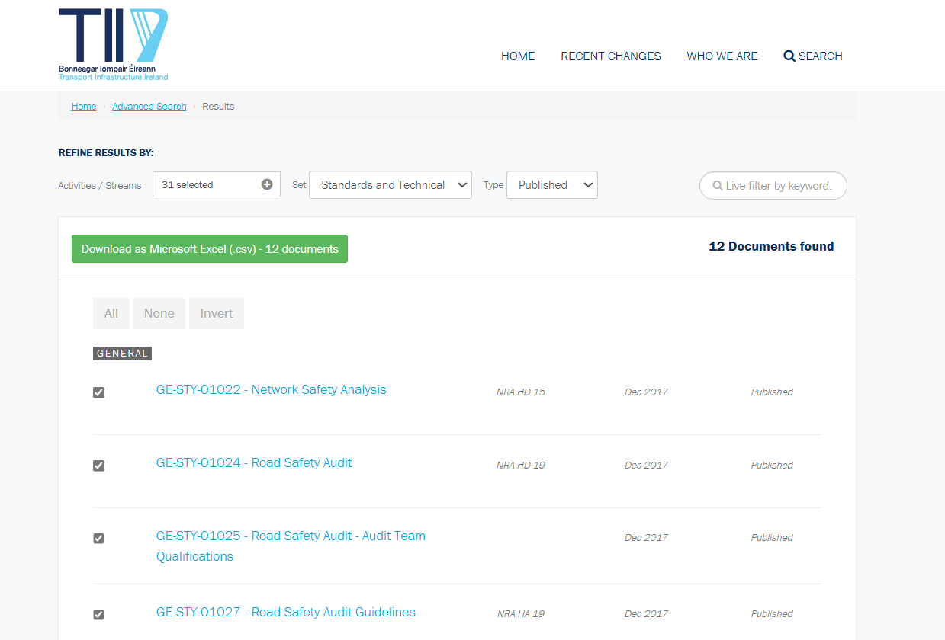

Slide 21
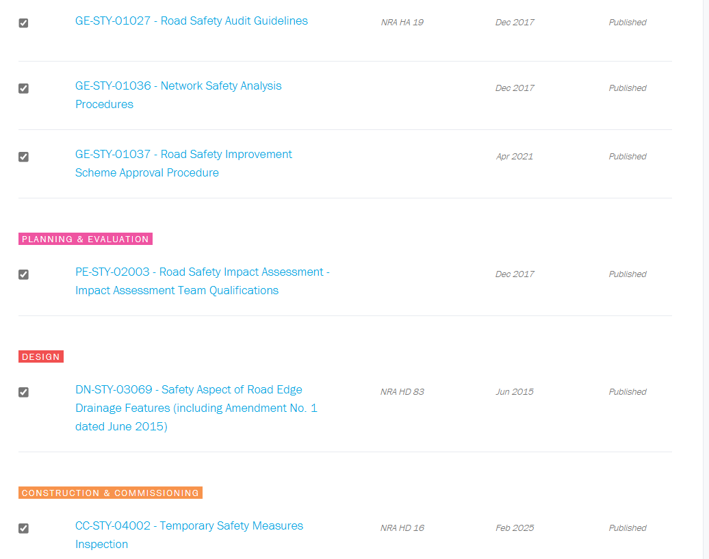

Slide 22
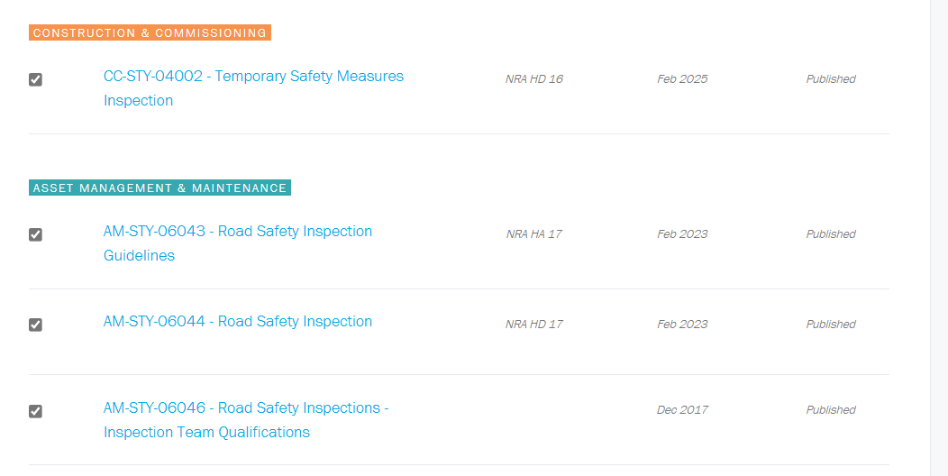

Slide 24
TII publications from last 12 months Road Safety and relevant others
Document Number | Document Title
CC-STY-04002 | Temporary Safety Measures Inspection
AM-PAV-06046 | Skid Resistance Management for National Roads
CC-PAV-04018 | Investigating Unexpected Skid Resistance Performance of Bituminous Surface Course Materials

Slide 25
Doc Number CC-STY-04002
Temporary Safety Measures Inspection
DD MMM YYYY

Slide 26
Overview of the Publications
CC-STY-04002 Temporary Safety Measures Inspection - PUBLISHED
CC-STY-04005 Inspection Qualifications for Temporary Safety Measures Inspections - WITHDRAWN

Slide 27
Reasons for Update / New Doc
Reasons for the Update
Internal Audit
Withdrawal of Inspection qualifications
Revised RISM

Slide 28
Benefits
Benefits
  The tables showing the frequency of inspections have been streamlined and updated to make them easier to interpret
  Inspection reporting has been updated to be self-certification

Slide 29
Interactions with Other Disciplines
Stakeholder Engagement
TII Network Operations
Consultant undertaking inspections
Standards Commission Technical advisor Arup
Internal Auditor

Slide 30
Key Changes/Updates
Key Changes/Updates
The Standard has been revised to reflect changes in European and National legislation.
CC-STY-04005 Inspection Qualifications for Safety Measures Inspections has been withdrawn, and qualification criteria have now been included in this standard and aligned with the Temporary Traffic Management Operations Guidance documents available at https://www.trafficsigns.ie/ttm.
The scope requirements have been amended for sanctioned works.

Slide 31
Key Changes/Updates
Key Changes/Updates
Reference to the TII Temporary Safety Measures web-based database has been updated.
The tables showing the frequency of inspections have been streamlined and updated to make them easier to interpret.
Inspection reporting has been updated to be self-certification.

Slide 32
How Will this Affect Projects?
How will this affect projects?
There should be no effect on current projects as a lot of the changes were made to be consistent with existing procedures.

Slide 33
Focus for next 12 months Road Safety
Divided Roads
Network wide Road Safety Assessment
Guidelines for rural bus stops
VRS assessments
VRS standards updates
Collision reduction tool training

