Slide 1
TII Road Safety Seminar
9th of April 2025,
Athlone.
Update on Road Safety Audit Approvals
Lucy Curtis CEng MA MIEI MCIHT HonMSoRSA
TII Regional Road Safety Engineer

Slide 2
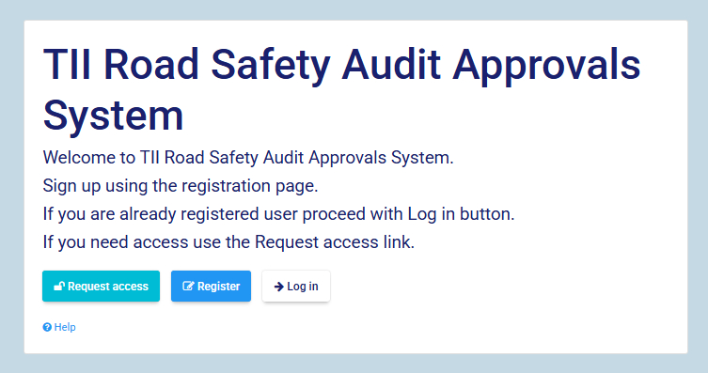
The new Road Safety Audit Approvals System
https://web.tii.ie/rsa/

Slide 3
New registrations in first year May 2024 – March 2025
Auditors
Over 40 in first month.
Tailing off to single digits

Slide 4
Auditors

Slide 5
All auditors approved since the start of road safety audit in 2000
From January 2000 to April 2025
561 auditors in total
276 team members
285 team leaders
Anyone who has qualified as team leader at any time in past 25 years

Slide 6
Auditors at March 2024
Just before the switch to the new system
357 auditors registered in total
176 team members
66 team leaders
115 ex-team leaders
Over 200 of these are not involved in road safety audit any more

Slide 7
Auditors registered on new system
Since 25th April 2024
156 auditors in total
98 team members
58 team leaders
125 re-registered
31 new (1 TL)

Slide 8
Auditors recently active
Final year old system 2023/2024
First year new system 2024/2025
112 active auditors
48 team members
64 team leaders
156 auditors registered
98 team members
58 team leaders

Slide 9
Audits

Slide 10
Registered Audits by year from the very start – 3420 audits

Slide 11
Approved audit stages 2010 - 2025
Historically,
far too many stage 1&2
Almost 900 stage 1&2
but only 500 stage 1

Slide 12
Approved audit stages Apr 2024 – Mar 2025
Finally, more stage 1 than stage 1&2
62 stage 1&2
Most of these are audits that are being registered retrospectively
Objective is to reduce stage 1&2 numbers more

Slide 13
Stage 1&2
There are very few circumstances in which stage 1&2 is appropriate
Only for very small schemes or schemes where sufficient detail can be included in the initial drawings.
The basic rule:
Audit can be Stage 1&2 only if the drawing includes all detail needed for it to be handed over to contractor or area office to construct
Otherwise it’s a stage 1

Slide 14
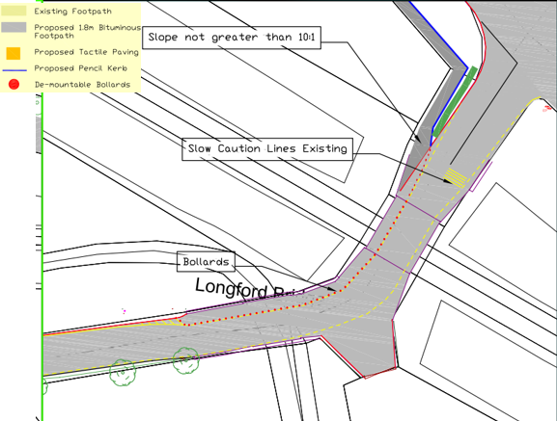
A stage 1 drawing. Unsuitable for stage 1&2
No widths
No levels or gradients
No wall heights
No kerb heights
No drainage
No signs

Slide 15
TII Road Safety Seminar
9th of April 2025,
Athlone.
Thank you

